Slide 1
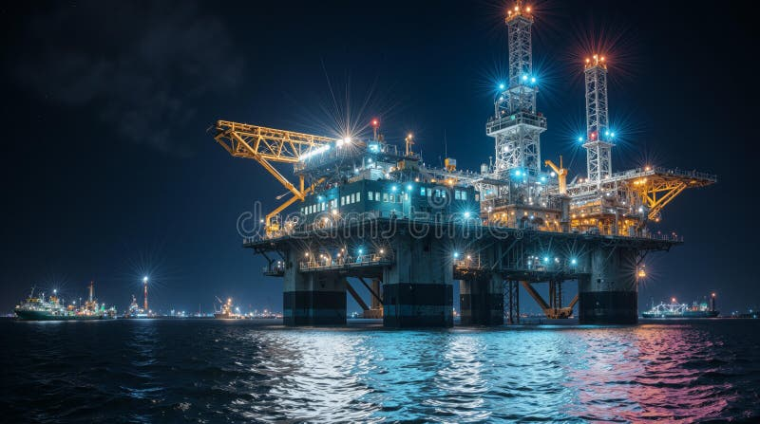


Feb 2026
Alma-Tech Inc.
Metal Additive Manufacturing
Certification-Ready Digital Inventory for Remote Industrial Assets
Enabling class-compliant additive manufacturing for offshore and maritime operations
$4.5M
$88M
Unused Inventory
Annual Downtime Cost
— Validated across 35+ interviews with ExxonMobil, Equinor, utilities & defense
Founders
Alireza Vahedi Nemani
Mahmoud Kiasari
PhD Candidate, Materials Engineering
PhD Candidate, Researcher
Dalhousie University

Slide 2
The Problem
Remote Industries Are Bleeding Capital on Inventory They'll Never Use
The Inventory Trap
The Downtime Disaster
The Logistics Nightmare
$30-50M inventory per offshore vessel
Single transformer: $100K
Chopper: Fast, costly, light loads only
$4-5M for $50M utility (8-10% of asset value)
Single turbo: $200K+
Supply vessel: Cheap, heavy, but SLOW (10+ days)
Downtime cost: $500K - $7M/day
80% sits unused, rusting
Arctic winter failures = air freight at 10x cost
Arctic access windows create stranding
15-20 year equipment lifecycles → obsolescence crisis
Summer sealift vs winter air freight amplification
"80% of physical inventory worth $4.5 million is unused"
"There is up to 88 million dollar downtime cost annually"
"We charter aircraft for a doorknob"
Validated by talking with various industries
35+ Interviews

Slide 3
Why Now?
The Industry Already Knows Digital Inventory Works—They're Just Waiting for Someone to Handle Certification
Major Operators Already Investing
The Missing Piece—PERMISSION
ExxonMobil
Multi-Year
Value-Capability-Permission Framework (Tyler Beatty)
SMART Labin MUN
VALUE: PROVEN
Full supply chain: Materials → Printing → Certification → Testing
"Eliminate supply chain = value"
Multiple metal printers deployed
CAPABILITY: PROVEN
FieldNode consortium member
"We can print parts"
PERMISSION: BLOCKED
"Certifying authorities haven't led charge"
Equinor + ExxonMobil
Multi-Year
"Real stifling of innovation"
Equinor contracted Siemens for digital inventory platform
— Tyler Beatty, ExxonMobil R&D Advisor
Goal: Digitalize 50% of inventory in 10 years
Platform model: "Send CAD to local facility close to location"
"Equinor did same thing... asked Siemens" — Dr. Nasiri
This is where AddManuChain comes in
Canadian Navy
Active
The market isn't waiting for proof-of-concept. It's waiting for someone to solve certification.
Thales + Cove partnership for Arctic Patrol Vessels
AM challenge: "Digital library" of parts (our exact concept)
"Beginning of challenge" = early stage opportunity

Slide 4
The Solution
AddManuChain: Certification-Ready Digital Inventory + On-Demand Metal AM
"We don't sell 3D printers. We end the War on Inventory."
1
PERMISSION
2
INTELLIGENCE
3
NETWORK
Certification-as-a-Service
AI Supply Chain + Digital Inventory
End-to-End Implementation
Partner with DNV, Lloyd's Register, ABS
Predictive maintenance integration
Assessment: Which 5-20% viable for AM?
Pre-certified parts library
Full manufacturing recipe (not just CAD)
Adoption: Training, equipment integration
"We handle certification so you don't have to"
Digital twin simulation
Integration: ERP systems
Aerospace-first strategy
Closed-loop feedback
Maintenance: Ongoing support
Unlike Competitors (FieldNode, Spare Parts 3D, Siemens)
They provide files only
We provide compliance-ready manufacturing recipes
They require external certification
We deliver pre-certified parts
They're Europe-focused
We're Canada-first (no established competitor)
They sell software/consulting
We deliver printed, certified, installed parts
"Digital inventory already exists BUT POORLY. File alone is useless—you need machine settings, parameters." — Nathan Smeenk, Agile Manufacturing

Slide 5
Go-to-Market Strategy
Beachhead: Arctic/Remote Operations → Scale: Oil & Gas + Defense
Why Arctic is THE Entry Point
Warm Referrals Secured
Logistics Cost
Access Windows
HIGHEST PRIORITY
Sealift vs air freight = 10x cost
Ice formation/breakup = STRANDED
Greda Aleirum — Equinor Global AM Lead
→ On-site AM eliminates air freight
→ Print on-demand during stranded periods
Tyler Beatty intro
Shawn Sooley — Shield Group CEO
Redundancy
Sovereign Resilience
Industry credibility partner
N+2 in remote mining (highest cost)
Federal mandate for northern independence
Engineered Intelligence
→ Digital inventory: N+2 → N+1
→ "Sovereign supply chain" positioning
AI asset intelligence (Adam Chubbs)
ECOSYSTEM ACCESS
CME NL
Market Expansion Path
NGen / Canada Makes
ERINL
PHASE 1
Memorial SMART Lab
Arctic Beachhead
Year 1-2
Utilities, Arctic mining, northern ops • Partners: Engineered Intelligence, C-CORE, ERINL • Revenue: 10 customers × $234K = $2.34M
PHASE 2
"Winter failure = air freight big time" — Adam Chubbs
Aerospace Certification
"Arctic + sovereign resilience = funding priority" — Keith Healey, ERINL
Year 2-3
"Aerospace First" strategy • PEEK printing • Partners: Shield Group, Memorial SMART Lab
PHASE 3
Oil & Gas + Defense
Year 3-5
ExxonMobil, Equinor partnerships • Canadian Navy (Thales/Cove), Irving Shipbuilding • Global expansion

Slide 6
Competitive Landscape
The Market Exists.The Timing Is Perfect.
Competitor | Market | Threat | What They Do | Why We Win
FieldNode | Europe O&G | HIGH | Digital inventory consortium | No AI, no cert, Europe → Canada-first, cert-ready, AI
Spare Parts 3D | Paris, O&G | MED | DigiPART software, 11% viable | Couriers, no cert, file-only → On-site, pre-certified, full recipe
Siemens | Enterprise | HIGH | Digital inventory platform | Expensive, enterprise-only → Scalable, cert bundled
Canada Makes | National | PARTNER | Part ID tool only | Part ID only → Integration opportunity
3D Printer OEMs | Equipment | LOW | Sell hardware | "How do I get my money back?" → Managed service wins
Local AM Bureaus | Service | LOW | Print services, no cert | No cert expertise → Potential partners
Certification Partnerships
Full-Stack Recipe
Industry Credibility
Material Science IP
DNV, Lloyd's, ABS relationships. Pre-certified parts library with network effects.
Not just CAD—machine parameters, materials, QA protocols. 9 publications database.
Dr. Nasiri (CRC), Shawn Sooley (Shield Group).
9 peer-reviewed publications. PH Martensitic SS development. Future: PEEK.
"How do you make it BETTER than what already exists?" — Nathan Smeenk challenge
Our Answer: Certification + Full Recipe + AI + Canada-First

Slide 7
Business Model
Managed Service Model: Setup + Subscription + Per-Part Revenue
1
Initial Setup
2
Monthly Subscription
3
Per-Part Production
Assessment + Equipment + Training + Integration
Platform Access + Support + Maintenance + Materials
Print-on-Demand Certified Parts
• Digital inventory audit (5-20% viable for AM?)
• Digital inventory platform (AI-enhanced)
• Pre-certified: Cost + 30%
• 3D printer installation
• Predictive maintenance integration
• New cert: Cost + cert fee + 40%
• Operator training & certification
• Equipment maintenance & troubleshooting
• Emergency: Cost + 50-100%
• ERP/digital inventory integration
• Material supply (metal powders)
• Average: $5K-$50K per part
• Initial pre-certified parts library (10-20 parts)
• Ongoing operator support & training
• Volume: 10-50 parts/site/year
• Certification updates & compliance
Price
Margin
Revenue
High Value
$90,000
40%
Price
Margin
Variable
Premium
$12K/mo
60%
Unit Economics (Per Customer)
Market Sizing (Conservative)
Setup fee
$90,000
Canada (Beachhead)
Year 1-3
Monthly subscription (12 mo)
$144,000
50 sites target
$17.2M by Y3
$200,000
North America
Year 4-5
Per-part revenue (20 parts @ $10K)
1,500 sites, 5% capture
$17.5M
Total Year 1 Revenue
$434,000
Global (Long-term)
Year 10
6,000 rigs, 2% capture
$28M
Ongoing Annual (Year 2+)
$344,000
✓ Recurring revenue
✓ High switching cost
✓ Network effects
✓ Aligned incentives
✓ Scalable

Slide 8
Traction & Validation
35+ Customer Interviews. $20 M Industry Investment. Warm Intros to Global AM Leads.
Customer Discovery Sprint (Jan-Feb 2026)
Warm Referrals & Partnerships
35+
$20 M
HIGHEST PRIORITY
Greda Aleirum
Customer Interviews
Industry Investment
Equinor Global AM Lead
Shawn Sooley
ExxonMobil R&D Advisor (18-year veteran)
Shield Group CEO
Equinor/Siemens digital inventory validation
Canadian Navy AM program discovery
ECOSYSTEM
Utilities, offshore, Arctic mining, defense
CME NL — 1000+ mfg
NGen — National
ERINL — $100-500K
Memorial — $17.5M
Key Validations
Technical Progress
$4-5M inventory
$30-50M inventory
9 publications
(carbon & stainless steels)
for $50M utility
per offshore vessel
— Adam Chubbs
— Jason Power
PH Martensitic SS
(in development)
$88M annual
Certification =
Non-ferrous & PEEK
(future pipeline)
downtime cost
THE barrier
— GE Oil & Gas
— Tyler Beatty
Current Support: Emera ideaHUB, CleanTech Commons, Lab2Market Oceans, Dalhousie

Slide 9
Team & Advisors
World-Class Material Science + Industry Insiders + Ecosystem Access
Founders
Strategic Partners (In Discussion)
AV
Alireza Vahedi Nemani
Shawn Sooley — Shield Group
Co-founder & CEO
CEO, active AM practitioner • Multi-sector exposure • Class society expertise
PhD Candidate, Materials Engineering, Dalhousie
"They're never going to do certification. I WILL do that."
9 Publications
LPBF Expert
Adam Chubbs — Engineered Intelligence
MG
Mahya Ghaffari
CEO, AI asset intelligence • Utilities & Arctic expertise • Digital twin integration
Co-founder & CTO
PhD Candidate, Materials Engineering, Dalhousie
C-CORE / Memorial SMART Lab
9 Publications
QA Protocols
Testing infrastructure • $17.5M ExxonMobil investment
Advisors
Why This Team Wins
Deep Technical Expertise
Industry Validation
Dr. Ali Nasiri
Ecosystem Embedded
Strategic Partnerships
Technical Advisor
Customer Access
Canada Research Chair, Ocean Engineering, Dalhousie
AM certification expert • Equinor/ExxonMobil connections
Harsimran Malhi
What We Still Need: Certification Expert (full-time), Operations Lead, Sales/BD Lead
Business Advisor
7 years O&G • MBA, Oxford Saïd Business School
Industry credibility • Deal structuring

Slide 10
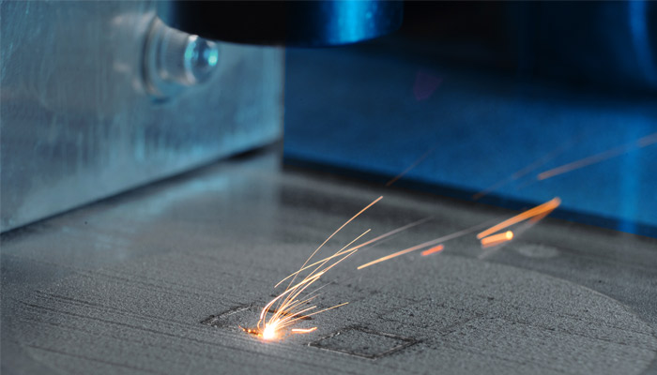
The Ask
We're Raising $2M to Validate Arctic Beachhead → Scale to Oil & Gas + Defense
Use of Funds (18-Month Runway)
18-Month Milestones
Certification Partnerships
$500K
M1-6
Foundation
Team Expansion (3 hires)
$600K
✓ 3 pilot customers
✓ DNV/Lloyd's MOU
✓ 20-part library
✓ Platform beta
Pilot Customers (3 sites)
$400K
$300K
M7-12
Validation
Technology Development
✓ Deploy 3 pilots
✓ Aerospace cert start
Operations & Overhead
$200K
✓ $500K non-dilutive
✓ Case study publish
TOTAL
$2M
M13-18
Scale
✓ 10 customers
✓ First aerospace cert
✓ Equinor/Exxon LOI
✓ $2M ARR, Series A
What We're Offering
Structure: SAFE or Priced Round
We Have / We Need
Target Valuation: $8-10M pre-money
WE HAVE:
WE NEED:
Goal: Scale beachhead → prove model → raise Series A
✓ Validated pain ($4.5B, $88M)
⏳ $2M to execute 18-month plan
✓ Proven solution (Equinor/Siemens)
⏳ Strategic investors (O&G/defense)
✓ Identified barrier (certification)
⏳ Non-dilutive partners (ERINL, NGen)
✓ Warm intros (Equinor, ExxonMobil)
✓ De-risked beachhead (Arctic)
Contact
$2M
Alireza Vahedi Nemani, CEO • Mahmoud Kiasari, Researcher
Alma-Tech Inc. • Dalhousie University
Seed Round

